Slide 1
EDUC2323 Computer Programming as a Tool for Learning
Strings Lists and Boolean Operators

Slide 2
Plan
Scratch blocks, concepts and techniques:
Manipulating text using ‘join’
Lists
Boolean logic: and, or, not
Tasks
Reviewing previous successful practical projects
Fortune telling programming task using lists and join
Reviewing blocks, concepts and techniques from today’s workshop (using handout)
Work on individual projects with support

Slide 3
Scratch Demo Projects (20 mins ish)
Intro to lists:
https://scratch.mit.edu/projects/140776476/
Accessing a list with an index variable
Using ‘item of’ block
https://scratch.mit.edu/projects/140869683/
Using two lists with a common index – Q&A style
https://scratch.mit.edu/projects/141244527/
Using two lists with common index
Using OR to accept more than one answer
Using broadcast messages to control sprite show/hide
https://scratch.mit.edu/projects/141243455/
Using ‘length of’ block
Using NOT and ‘list contains’ block as a simple search
Using Join to make text more interesting
Using ‘add to’ block to extend a list

Slide 4
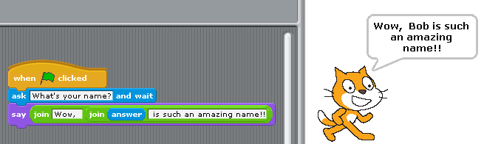
From numerical variables to strings, to lists
So far, our projects in class have only stored numbers in variables. But they can also store ‘strings’.
Strings are made of letters, words, or other characters (e.g., banana; January 2009; You lose!).
Strings can be stored in variables just like numbers
(If you try to use a string variable in a maths calculation, Scratch will regard it as a ‘0’)
You can join together strings using

Slide 5
Lists
LoFi list example
5 of you given a number
When I say your number say your name
Let’s change some values in the list
Let’s add some entries to the list
Let’s remove something from the list
Let’s look at this in scratch now

Slide 6
Lists
Lists are called ‘arrays’ in lots of programming languages
Lists are a type of variable which can hold more than one ‘value’ (e.g. number or string) – useful to hold related bits of information that we need to access within a project
Each value in the list is ‘indexed’ by a number. Most programming languages start list indexes at 0 but Scratch starts at 1, to match the way humans count.
Lists are very flexible – we can add new values, delete or change existing values.
… using an ‘index variable’ we can access the different values in the list as we need them. To create a list, go to the Variables blocks category and click:

Slide 7
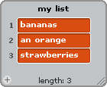
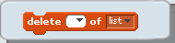

Lists are created ‘empty’ (i.e. containing no values)
When we create a list, a ‘list monitor’ appears on the stage.
You can see what’s in your list and also…
Type in values, and even…
Import them from files (if you have lots)
Each time you add a value to a list, it’s length will increase by 1.
The ‘add thing to mylist’ block adds a new value at the end of the list. But…
Using the following blocks you can also change or delete values anywhere else in the list
To access or change particular values in the list you need to know the ‘index’ of the value you want to change:

Slide 8








Other useful list-related blocks
A useful technique for quizzes and question/answer style games
Two (or more!) lists
One common index variable

Slide 9
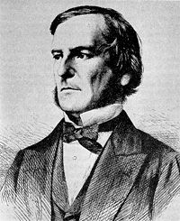

Boolean Operators
Named after 19th century English mathematician George Boole
Boolean operators result in either true or false outcomes
Whenever you see a hexagon-shaped block in Scratch it means that you can use a Boolean operator
Boolean expressions can be combined in certain ways
An and operator is true when both parts are true
An or operator is true is when either part is true
A not operator is true when the blocks inside are false

Slide 10

AND??????
Stand up if this condition applies to you
If you are a girl and you are
wearing blue
Why are you sitting??????
How many parts of the condition must be true
for you to stand up?????
rtccomputers.wikispaces.com/file/view/Boolean%20logic%20and%20randomness.pptx

Slide 11


Slide 12
OR????
You are a boy or you are wearing blue stand up
Why are you standing if you
are not wearing blue?????
How many parts of the condition
must be true for you to stand up?
If both parts are true is it ok to stand up???
rtccomputers.wikispaces.com/file/view/Boolean%20logic%20and%20randomness.pptx

Slide 13
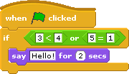

Slide 14
Let’s Look at the Demo Projects
Intro to lists:
https://scratch.mit.edu/projects/140776476/
Accessing a list with an index variable
Using ‘item of’ block
https://scratch.mit.edu/projects/140869683/
Using two lists with a common index – Q&A style
https://scratch.mit.edu/projects/141244527/
Using two lists with common index
Using OR to accept more than one answer
Using broadcast messages to control sprite show/hide
https://scratch.mit.edu/projects/141243455/
Using ‘length of’ block
Using NOT and ‘list contains’ block as a simple search
Using Join to make text more interesting
Using ‘add to’ block to extend a list

Slide 15
Lists task: Fortune Teller Game
First there should be a list to store the “answers” that the user will input
Your program will ask the user to how many “answers” they want to make for the fortune teller – store that number value into a variable.
Use a repeat loop for that number of times, to ask the user to input the possible “answers” for the fortune teller. As they specify them, add each to your list of “answers”. When the loop is done, you will have a list of possible answers.
Now make another loop that will repeatedly ask the user for their questions to be answered.
After each question is entered, randomly pick an “answer” from the list and then say “The answer to your question:” repeat the question “is: “ the answer you picked.
This will continue as long as your repeat loop goes, depending on how you control it.
When it is over, thank the user for using your fortune teller
Adapted from Garfield (2013): http://www.garfieldcs.com/wordpress/wordpress/wp-content/uploads/2013/04/List-Fortuneteller.pdf

Slide 16
Examples of past, successful practical projects
https://scratch.mit.edu/projects/141306636/
https://scratch.mit.edu/projects/141306772/
https://scratch.mit.edu/projects/141306861/
https://scratch.mit.edu/projects/141306967/
https://scratch.mit.edu/projects/141307042/

